Slide 1

DBA5103
Operations Research and Analytics
Zhenyu Hu
Semester I, 2026/2027

Slide 2
Course Information
Lecture hours:
  Wednesday 15:00–18:00, BIZ2-0509;
  Friday 12:00-15:00, BIZ2-0509;
  Friday 18:30-21:30, BIZ2-0509.
Instructor: Hu Zhenyu
  Email: bizhuz@nus.edu.sg
  Personal website: https://sites.google.com/view/zhenyuhu/home
Office hour: BIZ1 8-62, by appointment
TA: Zhao Yipeng, e1521284@u.nus.edu
Zhang Guoyun, e0773599@u.nus.edu
Website: Canvas
  Lecture materials
  Assignments and final project

Slide 3
A bit more about myself
B.S. in Mathematics
Ph.D. in Industrial Engineering
NUS Business School since 2015.
On research:
  Dynamic Programming
  Game Theory and Mechanism Design
On education:
  https://www.youtube.com/watch?v=Q1lL-hXO27Q

Slide 4
Textbook and Reference
Text:
  Introduction to Operations Research, Hillier and Lieberman (2015)
  Applied Mathematical Programming, Bradley, Hax and Magnanti (1977)
  Introduction to Linear Optimization, Bertsimas and Tsitsiklis (1997)
  Mostly, lecture notes
Software:
  Python (Anaconda) and Gurobi
  Excel Solver

Slide 5
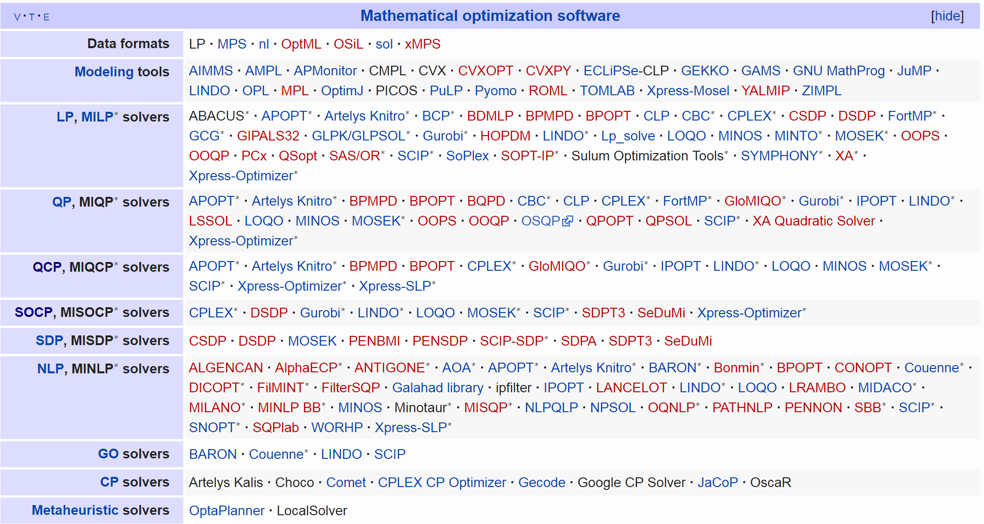
Optimization Software

Slide 6
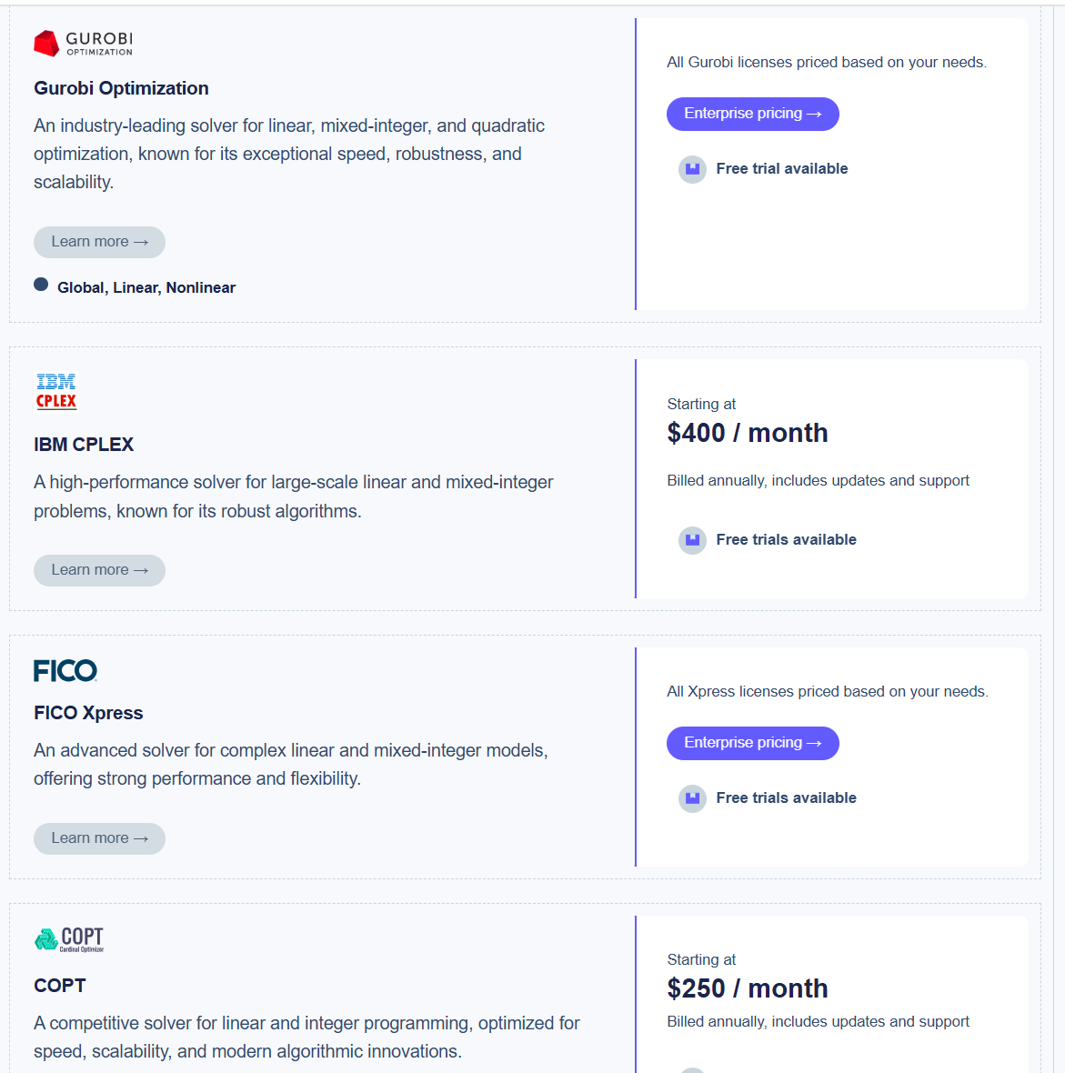
Optimization Software
https://ampl.com/pricing/

Slide 7
What You Should Expect
Mathematical Thinking
  Understand the basic logic behind algorithms
  Understand the general principles in optimization
  Judgement on the difficulty of a problem; be able to assess the quality of a solution
Analytics Skills
  Building up models
  Picking the right tools
  Implementing in Software

Slide 8
What I Expect
Prerequisite
  Linear algebra
  Basic probability theory
Assessment
  Team Term Paper 30%
  Individual Assignments 30%
  In-Class Quiz 30%
  Class Participation 10%

Slide 9
Homework 0
Download and install python (Anaconda distribution) and gurobi (academic license)
  Contact TA for help
Form a team
  5-6 students per team
  Deadline: recess week

Slide 10
Course Content
Theory and application of linear programming
Network flow models
Integer programming
Dynamic programming*

Slide 11
Operations Research in Practice

Slide 12
In a Nutshell
Decision
Maximize/Minimize …
Subject to …

Slide 13
Areas of Operations Research
Manufacturing
Transportation
Airline, Hotel and Retail
Synonyms and overlaps: Management Science, Decision Science, Industrial Engineering, Operations Management, Economics, Computer Science

Slide 14
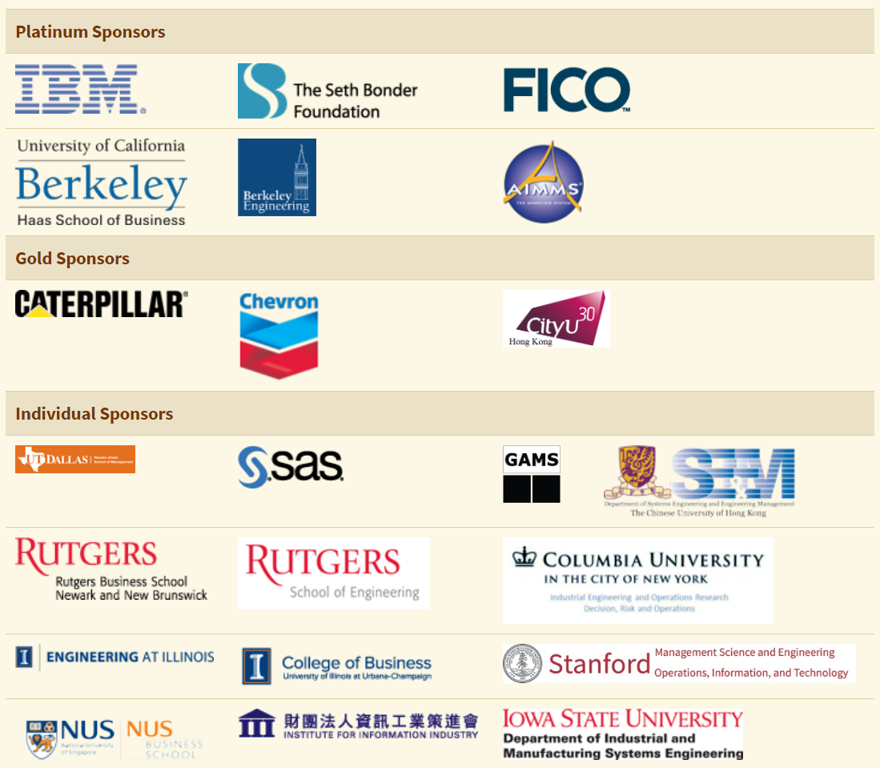
Areas of Operations Research

Slide 15
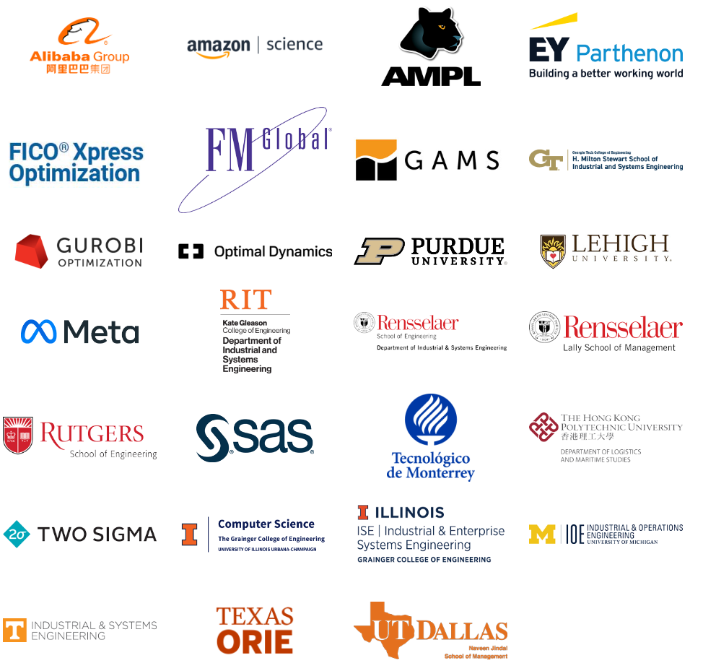
Areas of Operations Research

Slide 16
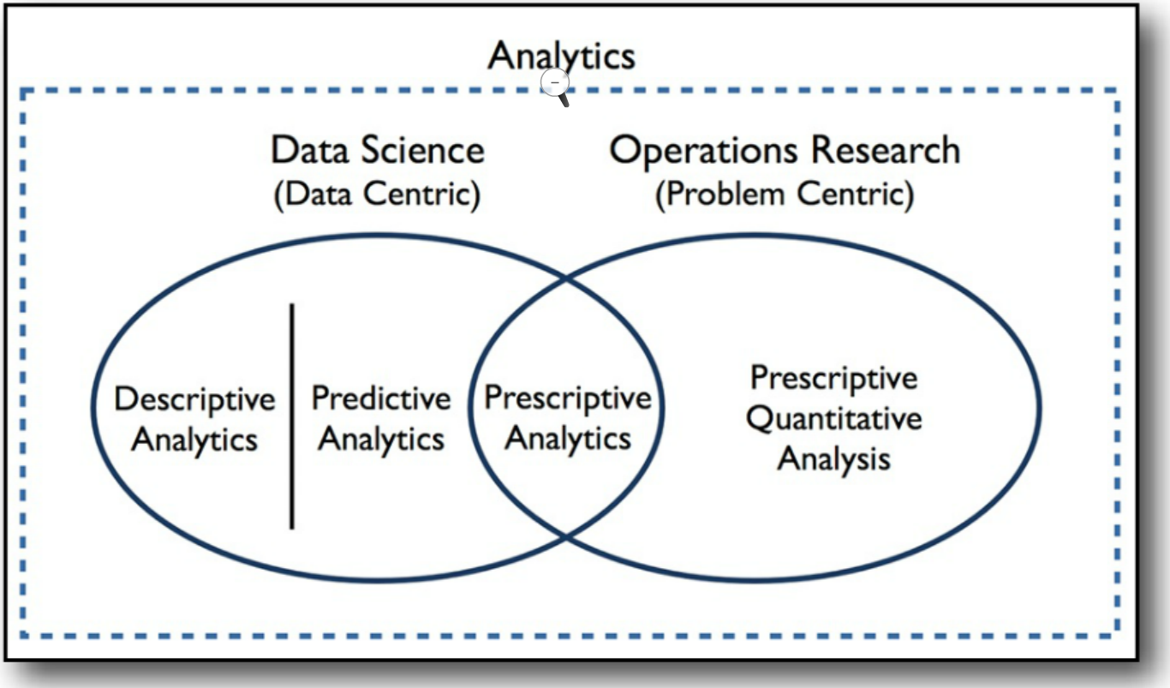
Rise of Analytics
Source: Robert Rose, “Defining analytics: a conceptual framework”, 2016, OR/MS Today, Vol. 43, No.3

Slide 17
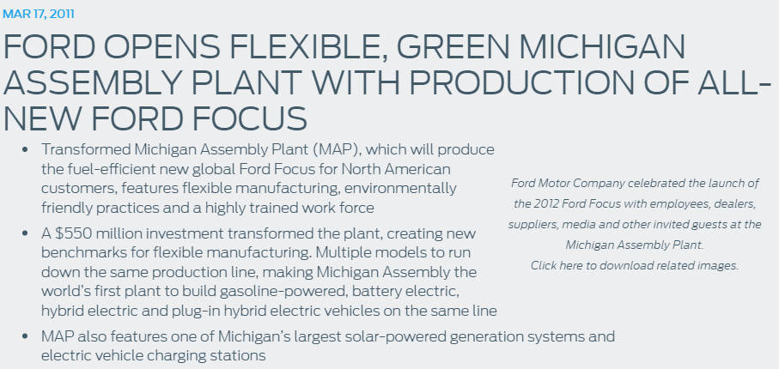
Ford

Slide 18
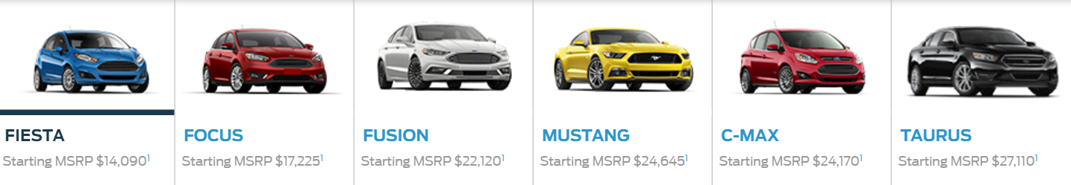
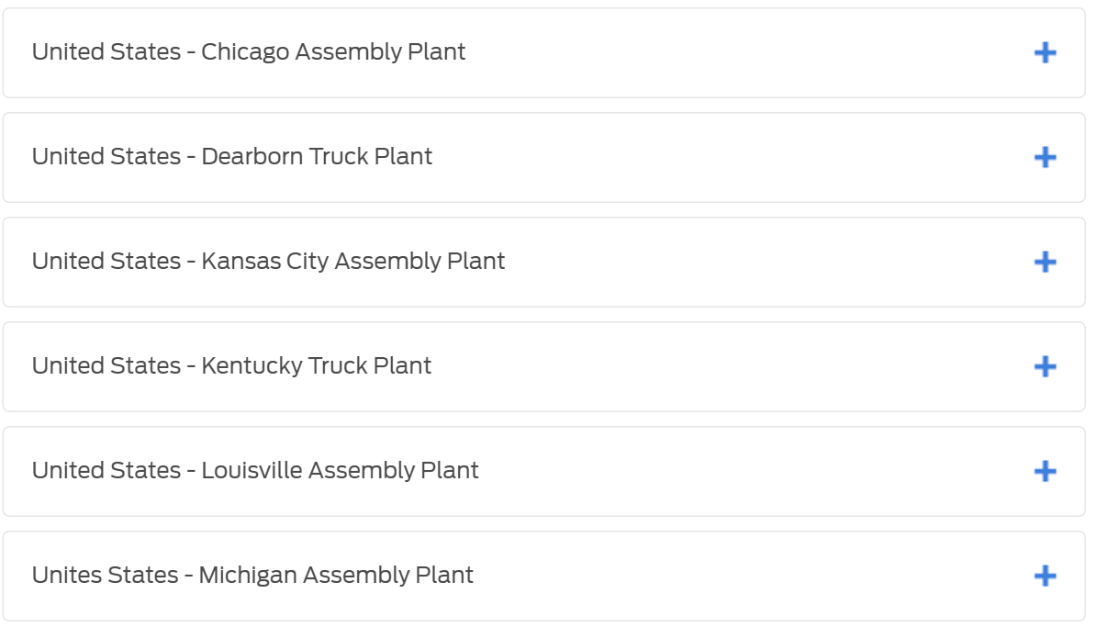
Flexible Manufacturing

Slide 19




Traditional Dedicated System
100
20
100
140
100
140

Slide 20
Full Flexible System
100
20
100
140
100
140

Slide 21
If we know demand…
100
20
100
140
100
140

Slide 22



How to Compute the Maximum Sales?
100
20
100
80
100
140
100
100
100
140
100
120

Slide 23
Operations Research Tools
Given a design, how do we evaluate its performance?
  Linear programming
  Maximum flow
  Simulation

Slide 24

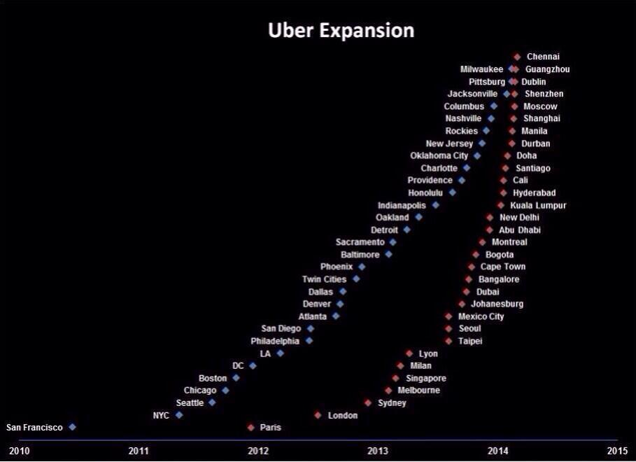

Uber

Slide 25
Uber/Grab
What does Uber/Grab offer?
Matching Algorithms
  Dispatch system
  Surge pricing
  Uber POOL/Grab Share

Slide 26
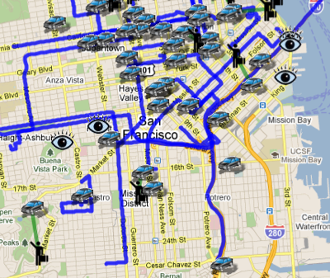
Dispatch System
Source: http://www.wired.com/2011/04/app-stars-uber/

Slide 27
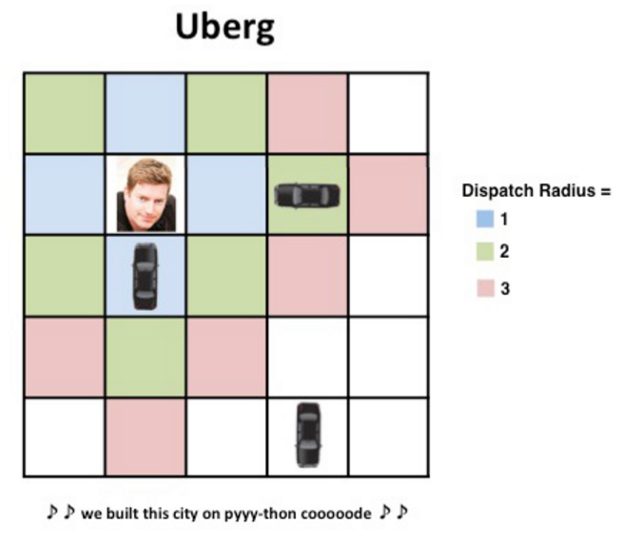
Greedy Approach
Source: https://newsroom.uber.com/semi-automated-science-using-an-ai-simulation-framework/

Slide 28


Is Greedy Good?
3 min
2 min
10 min
20 min

Slide 29
Operations Research Tools
Linear programming.
Shortest Path.
Assignment Problem.

Slide 30
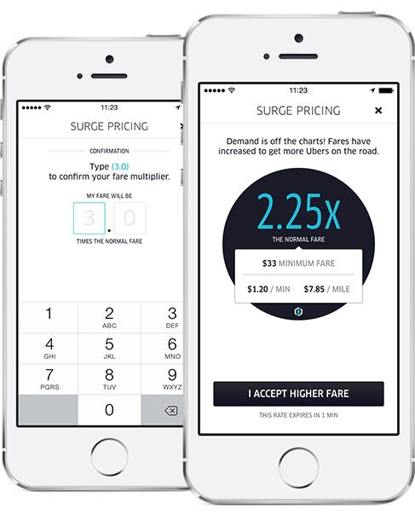
Surge Pricing

Slide 31
Why?
Profit Maximization?
  Compare to airline industry

Slide 32
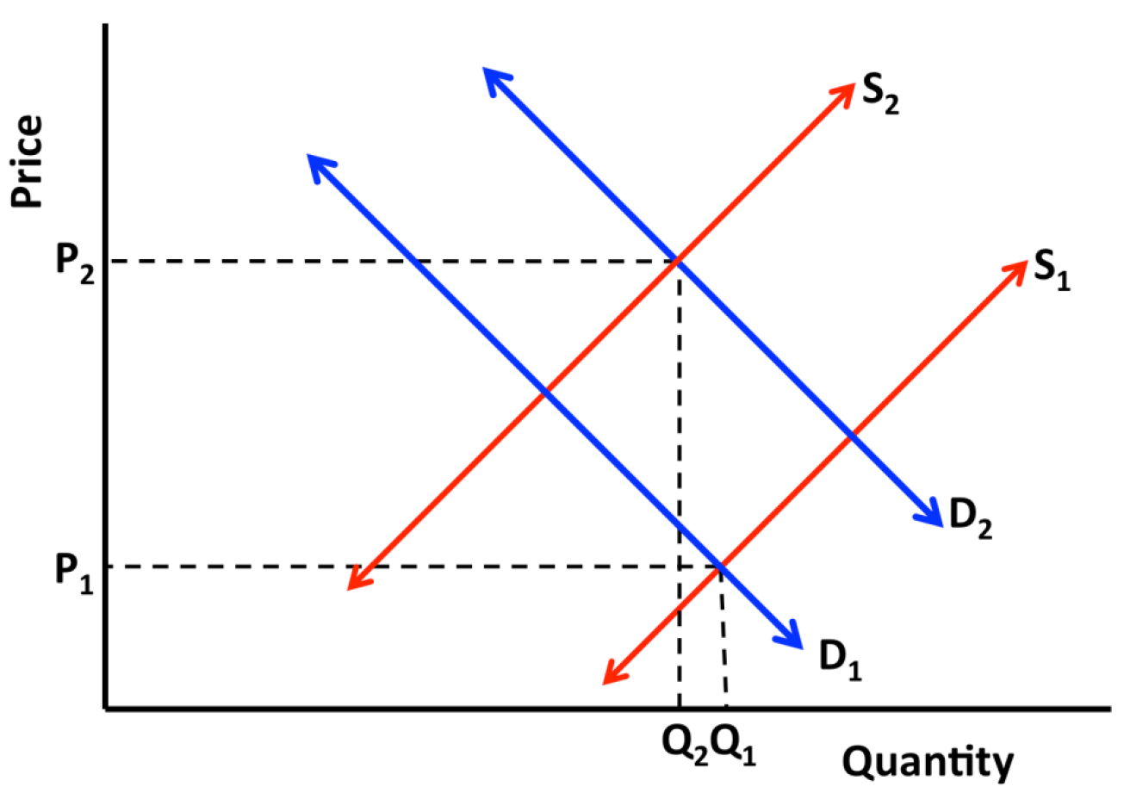
ECON 1001
Source: https://newsroom.uber.com/guest-post-a-deeper-look-at-ubers-dynamic-pricing-model/

Slide 33
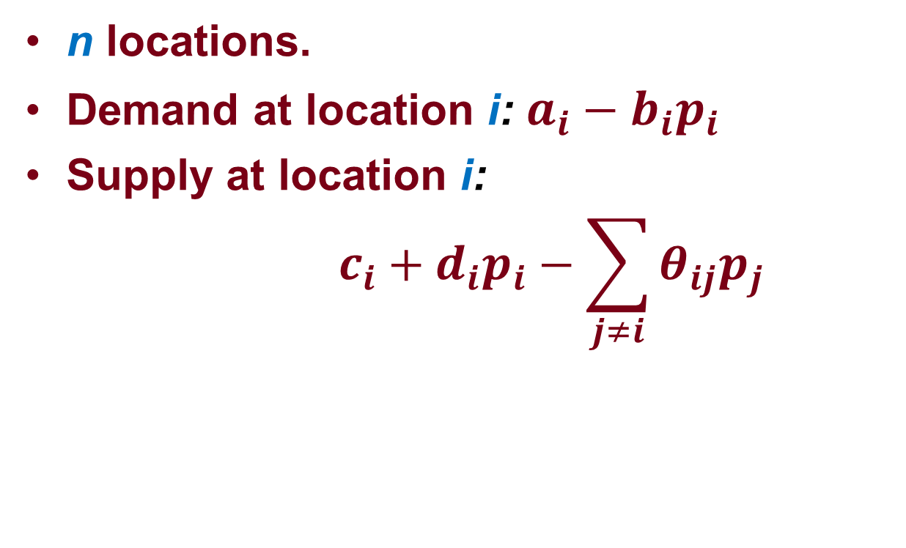
A Model for Supply and Demand
n locations.
Demand at location i: $a_{i}−b_{i}p_{i}$
Supply at location i:
$$c_{i}+d_{i}p_{i}−\sum_{j≠i}{θ_{ij}p_{j}}$$

Slide 34
Optimization Problem
Non-profit
  Linear programming (in fact, linear algebra)
Profit
  Nonlinear programming

Slide 35
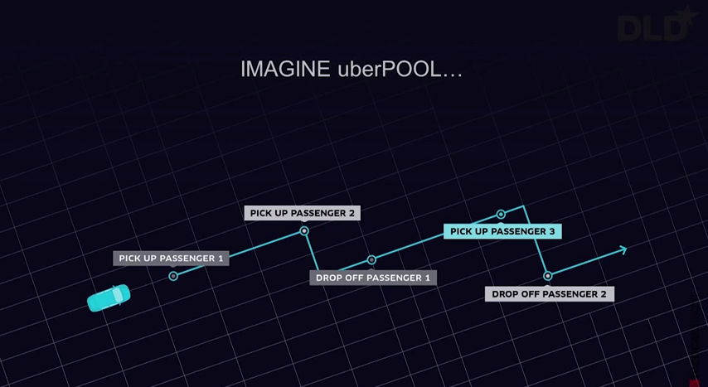
UberPOOL

Slide 36
Traveling Salesman Problem
End point
Drop off passenger 3
Pick up passenger 2
Pick up passenger 3
Pick up passenger 1
Drop off passenger 2
Start point
Drop off passenger 1

Slide 37
Solving TSP
Linear programming.
Integer programming.
Heuristic design.

Slide 38

Rue La La
Source: https://www.ruelala.com/boutique/

Slide 39
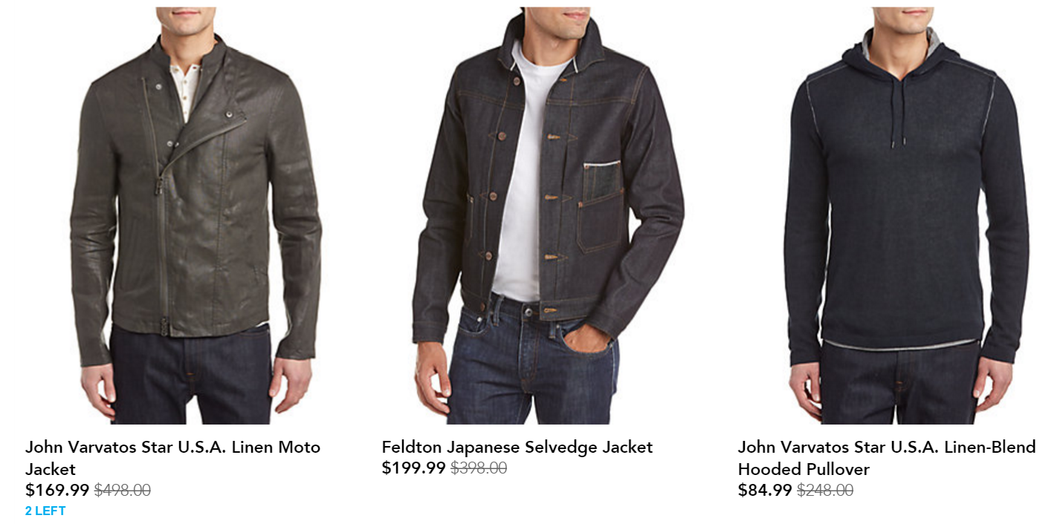
Rue La La
Legacy pricing process
  Percentage markup on cost
  Competitor’s price
  Subjective judgement
Source: https://www.ruelala.com/boutique/

Slide 40
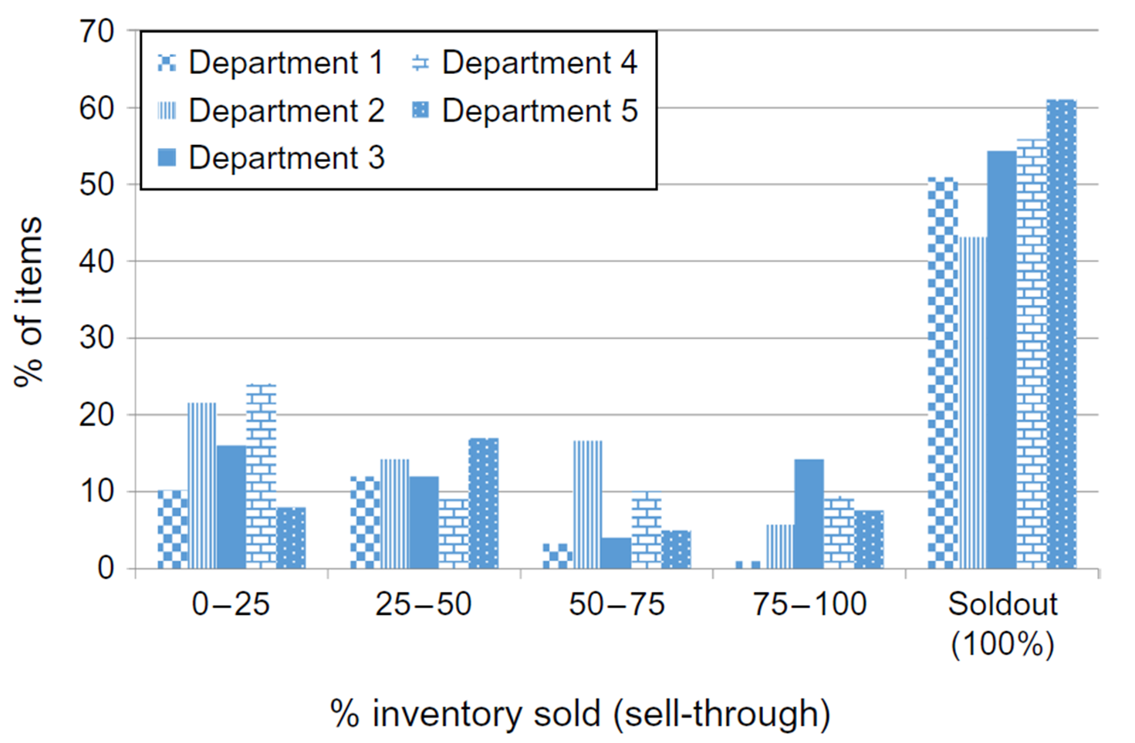
Rue La La
Source: Ferreria, Lee, Simchi-Levi (2016), “Analytics for an Online Retailer: Demand Forecasting and Price Optimization”, 2016, MSOM, Vol. 18, No.1

Slide 41
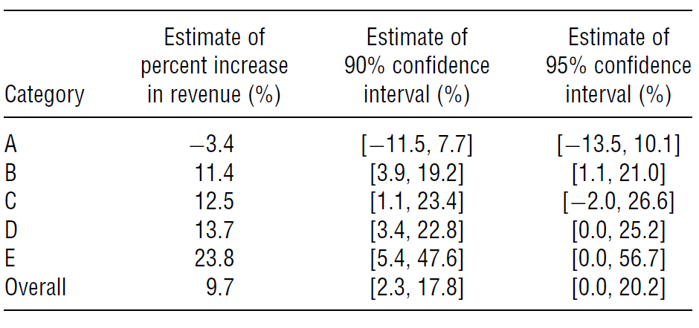
Price Optimization
Methodology
  Integer programming/ linear programming
Experiment
Source: Ferreria, Lee, Simchi-Levi (2016), “Analytics for an Online Retailer: Demand Forecasting and Price Optimization”, 2016, MSOM, Vol. 18, No.1

Slide 42
Other Ways of Improving Profit?
Markdown Management/Dynamic Pricing
  Inventory is determined before the selling season begins
  Dynamically reduce price over the selling season to boost demand and increase revenue
When to decrease and by how much? Tradeoff?

Slide 43
Dynamic Pricing
Linear programming.
Dynamic programming.

